Slide 1


ព្រះរាជាណាចក្រកម្ពុជា
ជាតិ សាសនា ព្រះមហាក្សត
សកលវិទ្យាល័យភូមិន្ទភ្នំពេញ
Assignment
Members group
Ghheav Sinh
Mab Met
Kol Panhadith
Chhon Menghong Corn Daveat
Group 3: Database systems
Lecturer: Var Sovanndara

Slide 2
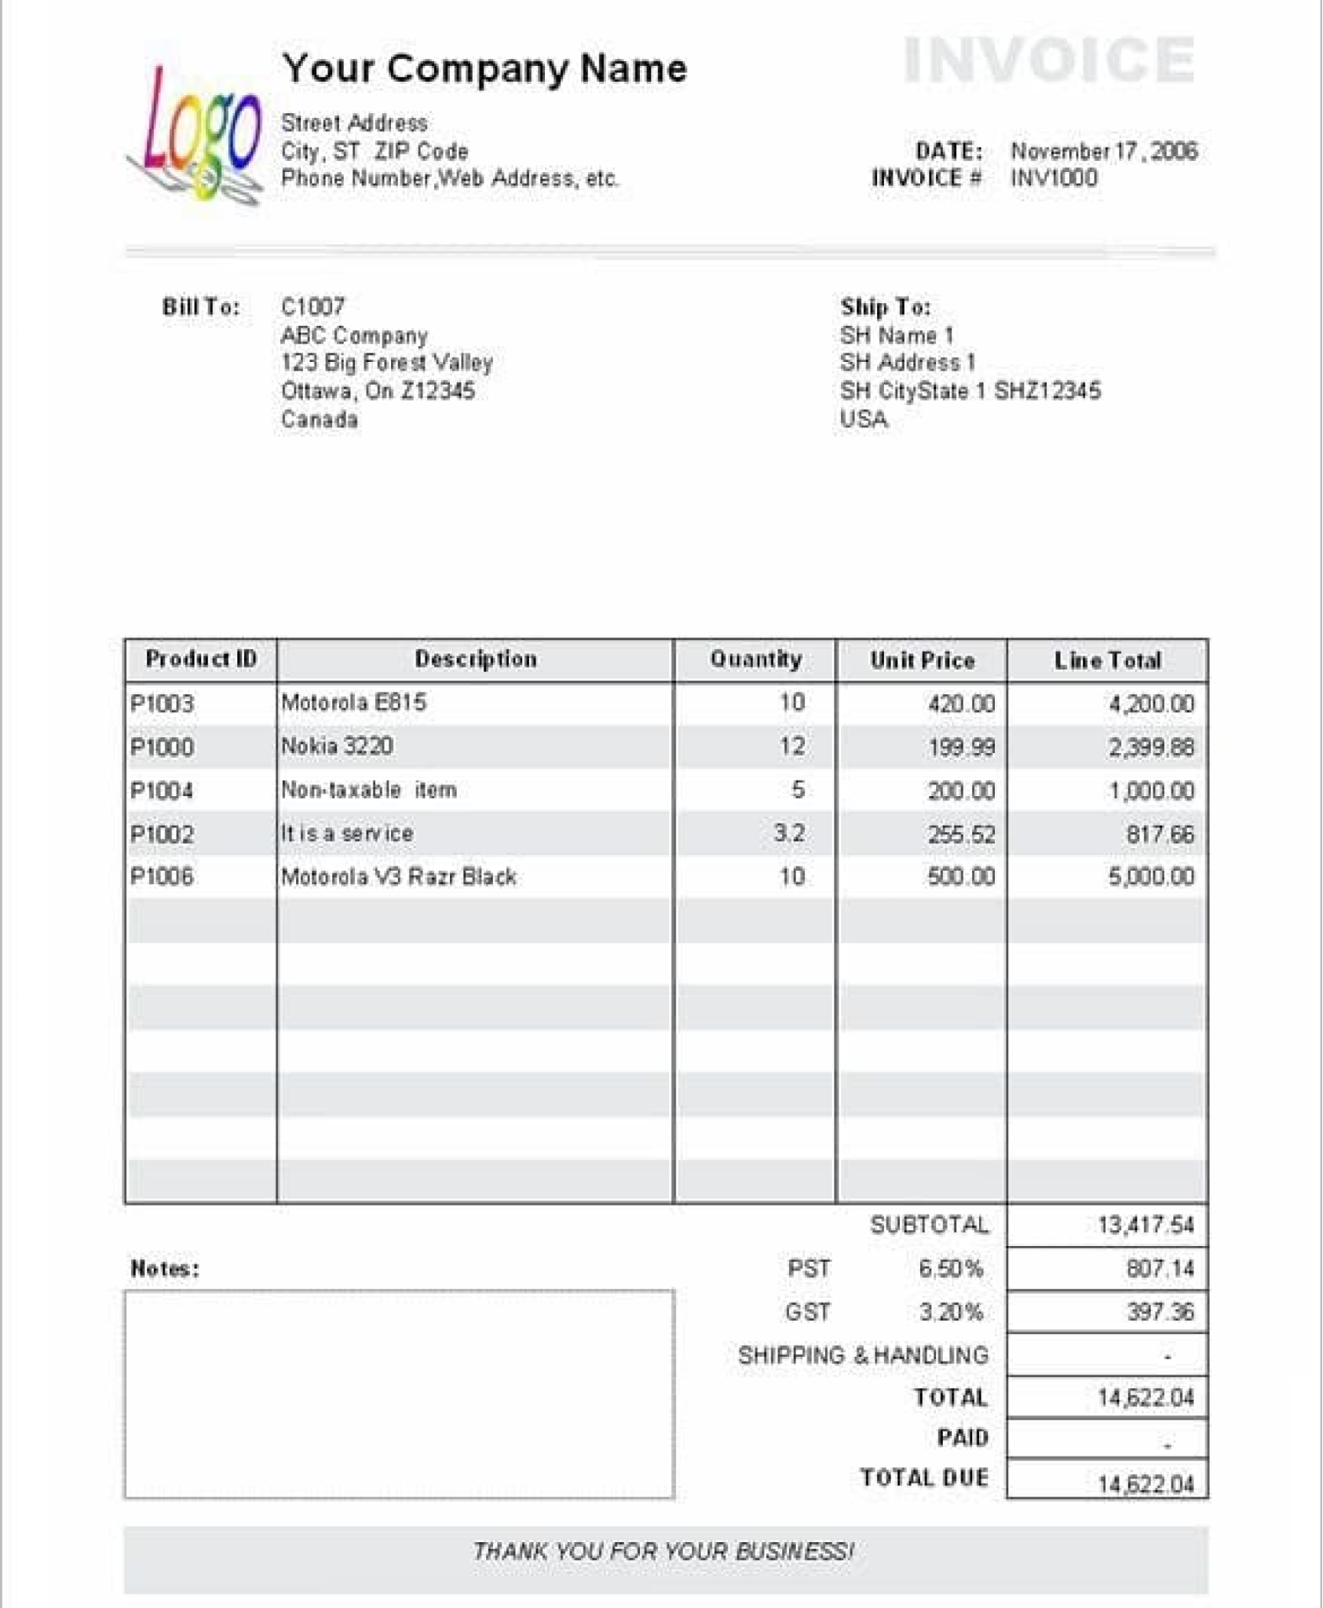
Sample Receipt

Slide 3
Master Details
UNF:
Invoice no | Date | Street | City | Phone | Bill to | Ship to | Sub Total | PST 6.50% | GST3.20% | Shipping & Handling | Total | Paid | PID | Des | Qty | Unit Price | Line Total
INV1000 | November 17, 2006 | 22E1 | Phnom penh | +85511223344 | C1007, PP | 2119 BTB | 13,417.54 | 807.14 | 397.36 | - | 14,622.04 | 14,622.04 | P1003 | Motorola E815 | Motorola E815 | 420 | 4200.00
A | B | C | D | E | F | G | H | I | J | K | L | M | N | O | P | Q | R

Slide 4
+ នាំឲយើងទាញបាន AនិងNជាPrimary Key កំណត់Bទៅដល់R
A, N => B.C.D.E.F.G.H.I.J.K.L.M, O, P, Q, R (PFD)
+ AជាPrimary Keyដែលកំណត់Bទៅដល់ជាផ្នែកMaster
(i) A => B.C.D.E.F.G.H.I.J.K.L.M
+​ Nជាផ្នែកDetail ហើយNកំណត់តែoមួយគត់
(ii) N => O
+ តាមរយះ(i) យើងអាចទាញបានតារាងក្នុងទម្រង់2NFដូចខាងក្រោម:
tbInvoice(A, B, C, D, E, F,G,H.I.J.K.L.M)
+ តាមរយះ(ii) យើងអាចទាញបានតារាងក្នុងទម្រង់2NFដូចខាងក្រោម:
tbProduct(N, O)
+ តាមរយះ(i & ii) យើងបាន => tbInvoiceDetails ( A, N, P, Q, R ) ជាតារាងស្ថិតនៅទម្រង2NF

Slide 5
2NF
tbInvoice(A, B.C.D.E.F.G.H.I.J.K.L.M.N )
tbProduct( N, O )
tbInvoiceDetail ( A, N, P, Q, R)
3NF: ​​​
tbProduct( N, O ) (Strong)
tbInvoice(A, B.C.D.E.F.G.H.I.J.K.L.M.N) (Strong)
tbInvoiceDetail ( A, N, P, Q, R) (Associated)

Slide 6
Data Dictionary
Table’s Name | Attribute | Description | DataType | Null or Not | PK/FK | References
tbPro | productID | product’s identity | INTEGERY | NOT NULL | PK
 | productname | product’s name | VARCHAR(20) | NOT NULL
tbInv | invoiceId | Invoice’s identity | INTEGER | NOT NULL | PK
 | Date | invoice date | DATE | NOT NULL
 | subTotal | Sub Total invoice | INTEGER | NOT NULL
 | total | Total invoice | INTEGER | NOT NULL
tbInvoiceDetail | invoiceNo | invoice’s number | INTEGER(Auto) | NOT NULL | PK/FK | tbInvo
 | pid | Product’s Code | INTEGER(auto) | NOT NULL | PK/FK | tbPro
 | Qty | Sale quantity | INTEGER | NOT NULL

Slide 7
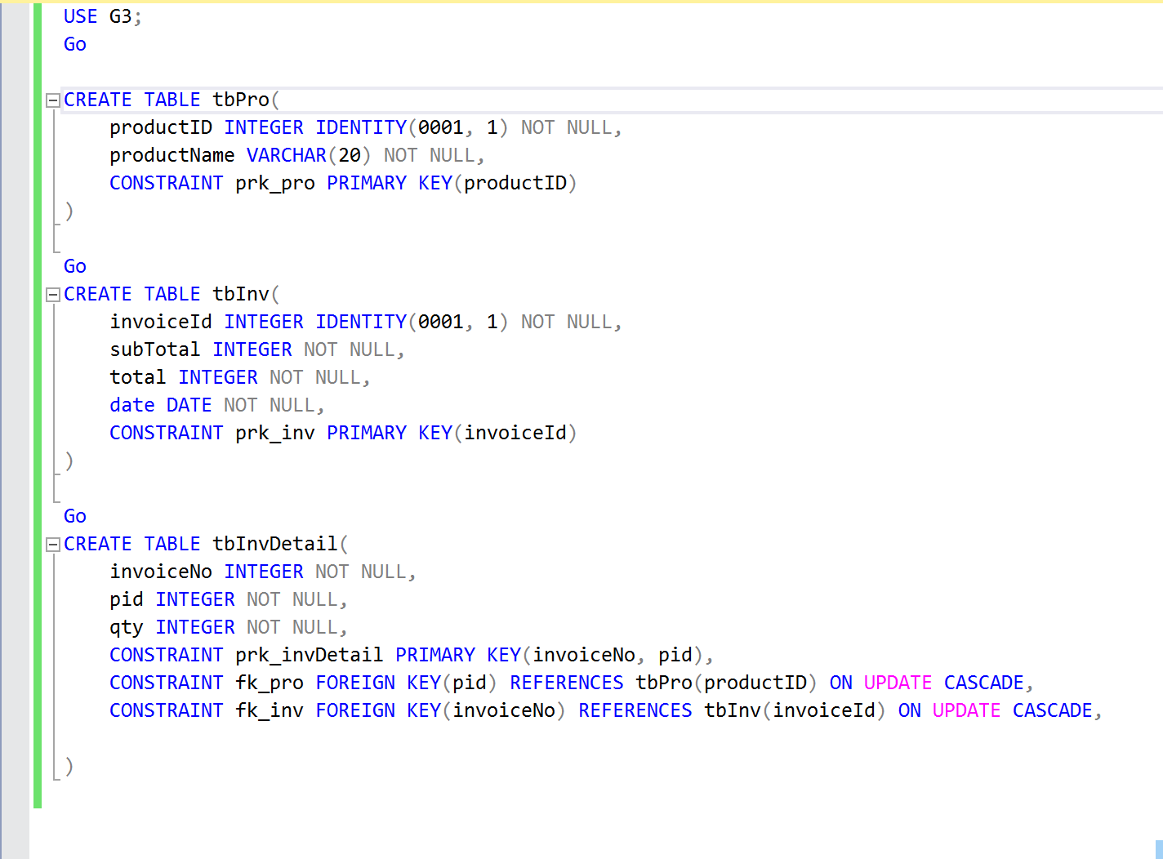
Source Code

Slide 8
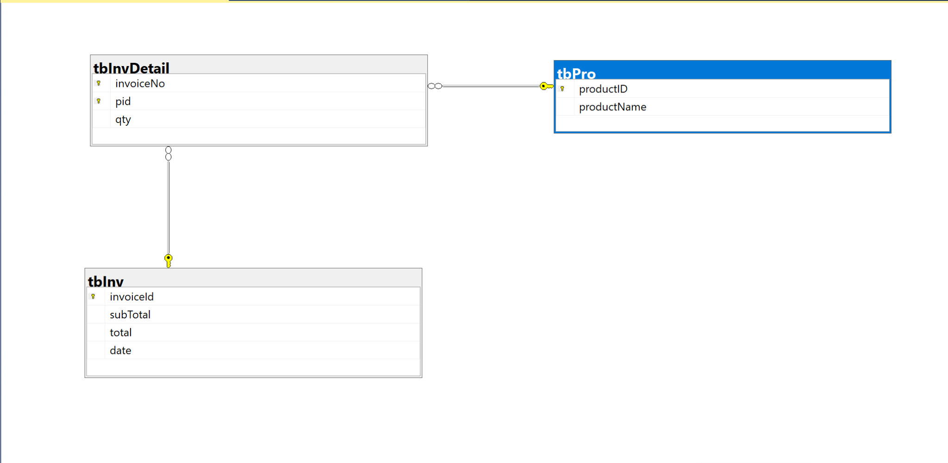
លទ្ធផល

Slide 9
Thank you

